Slide 1

E-COMMERCE unit 15

Slide 2

AGENDA
Distinguish between B2C, B2B, and C2C E-commerce models, citing examples for each type.
Learn specific vocabulary
Explain the advantages of E-commerce for businesses and consumers;

Slide 3

2. How does online shopping help businesses?
1. What do you buy online?
Let’s talk about these questions

Slide 4




Enhance your vocabulary
E-commerce – is the purchase or sale of items on the internet.
Traffic – is the total number of users that go to and view a website in a certain amount of time.
Affiliate – is a person or business that directs Internet traffic to a business’s website in exchange for a percentage of sales.

Slide 5
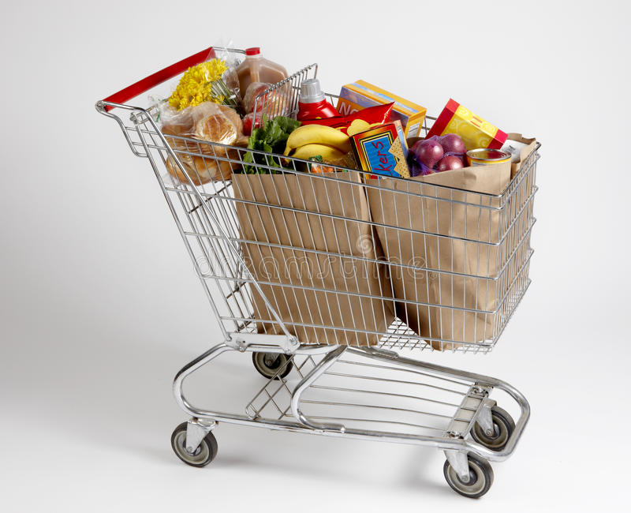


4. Shopping cart – is a part of an online store that displays items that a consumer has selected for purchase , but has not yet paid yet 5. FAQs – (Frequently Asked Questions) are a set of questions and answers that are provided on a website to provide users with information that users commonly want to know 6. Brick and mortar – is a business that operates in a physical location instead of online

Slide 6

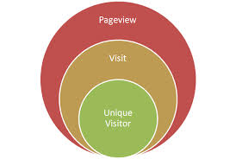

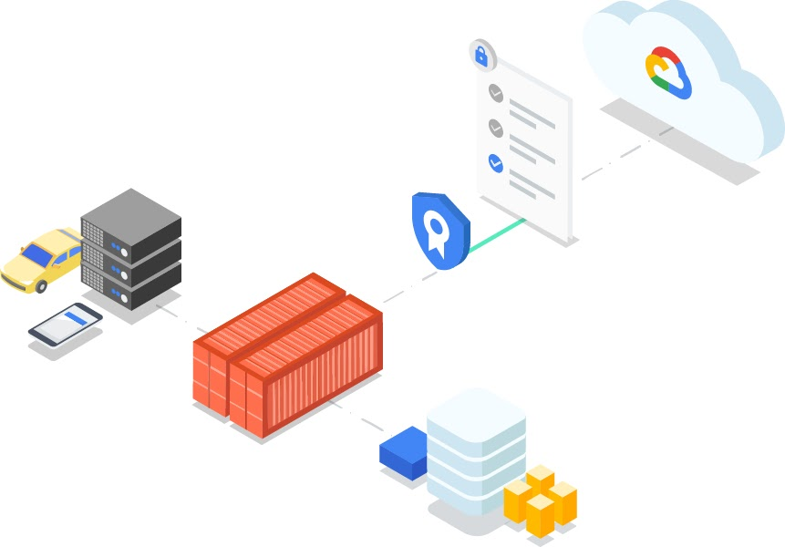
7. Page views – is a request from a computer to load a page of a website. They can be counted to analyze the number of people viewing a website. 8. Digital certificate – is an electronic document that proves an online business or person is who that business or person claims to be. 9. Certificate authority – it creates, offers and verifies reliable digital certificates.

Slide 7

What are the advantages and disadvantages of e-commerce?
Let’s brainstorm
Pros | Cons

Slide 8
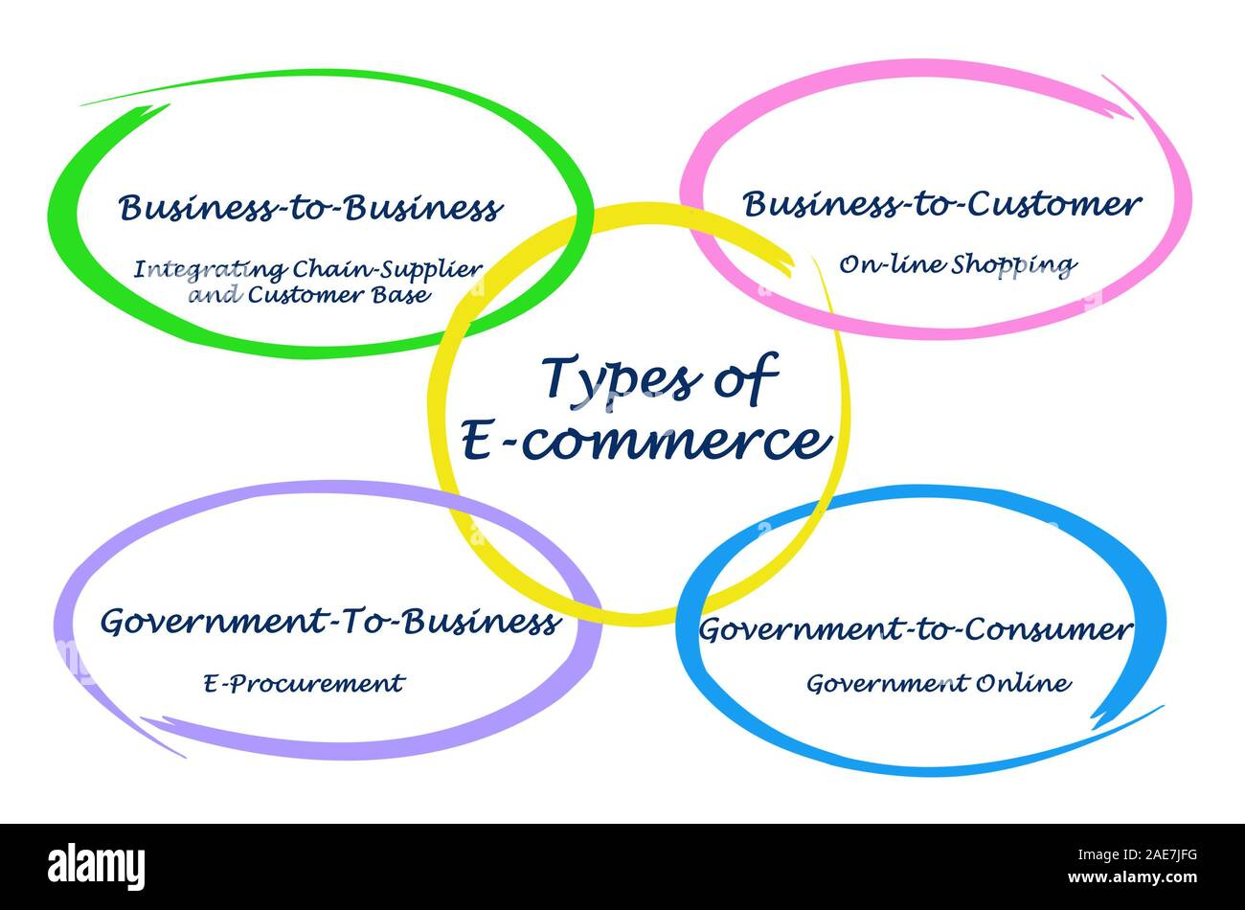
Let’s distinguish between B2C, B2B, and C2C E-commerce models and identify which type(s) you use most often and why.

Slide 9

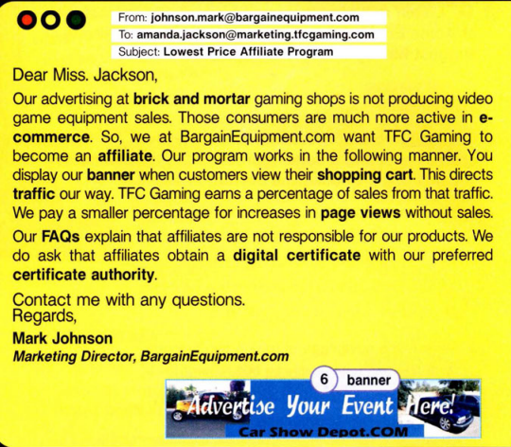
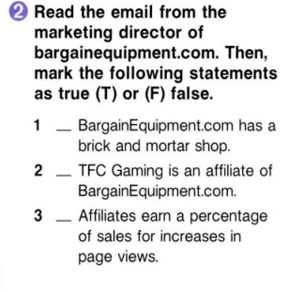

OUR COMPANY
F
Mercury is the closest planet to the Sun and the smallest one in the Solar System—it’s only a bit larger than the Moon
F
T

Slide 10
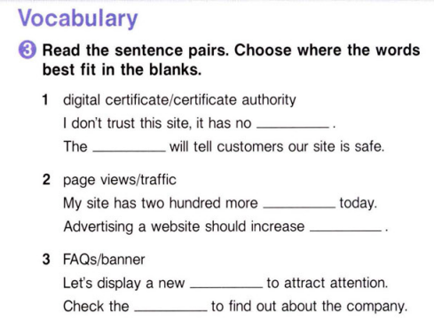
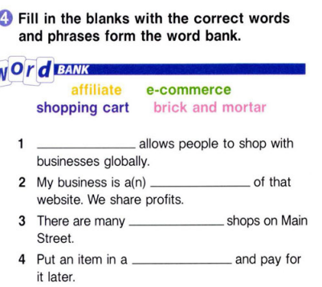
MERCURY
MARS
digital certificate
certificate authority
Mercury is the closest planet to the Sun
Despite being red, Mars is a cold place
E-commerce
VENUS
SATURN
Venus has a
beautiful name
page views
Saturn is the ringed one and a gas giant
affiliate
traffic
JUPITER
NEPTUNE
It’s the biggest planet in our Solar System
brick and mortar
It’s the farthest planet from the Sun
banner
FAQs
shopping cart

Slide 11


Listen to part of a conversation between employee of BargainEquipment.com and TFC Gaming. Choose the correct answers.

Slide 12


Listen to part of a conversation between employees of BargainEquipment.com and TFC Gaming. Choose the correct answers.
1. What are the employees mostly talking about?
A. raising sales
B. meeting affiliates
C. calculating profits
D. payment percentages
2. TFC Gaming earns a half percent for ... .
A. each sale
B. slowing traffic
C. 100 page views
D. becoming an affiliate

Slide 13
Listen again and complete the conversation
Amanda: Hi Mark. This is Amanda from TFC Gaming.
Mark: Hi Amanda. Glad to hear from you.
Amanda: Well, we're definitely interested in being an 1) _________. But we have some questions.
Mark: Of course. What do you want to know?
Amanda: About the 2) __________. What do we earn for just an increase in 3) ________ __________?
Mark: That's 0.5% per hundred.
Amanda: I see, and for sales from our 4) _________?
Mark: All BargainEquipment.com affiliates get 2% of the 5) ________ _________.
Answers: 1. affiliate; 2. percentages; 3. page views; 4. traffic; 5. total profit

Slide 14
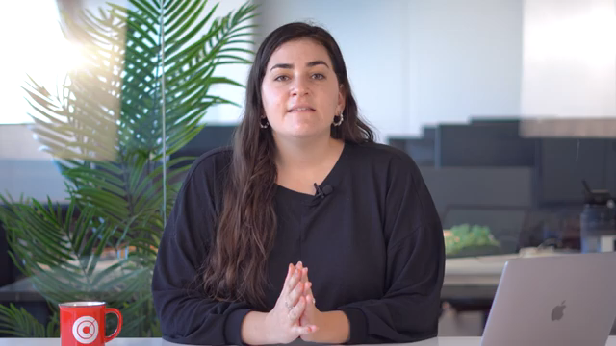
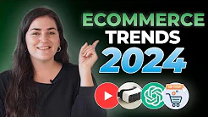
Watch a video and based on it, discuss how these trends impact consumers and businesses.

Slide 15



Group Work Activity
In a group of 4-5 students research and present about popular E-commerce platforms in different countries (e.g., Alibaba in China, Flipkart in India). Compare the features, target audience, and unique selling points of these platforms.

Slide 16

Watch the video and mark the following statements as True or False.

Slide 17
1. A recent study shows that Australians are not making online purchases.
True
False
2. According to the same study, 59% of small and medium-sized businesses take orders online.
True
False
3. The company JR Apparel does everything online, from banking to taking orders.
True
False
4. Online businesses can reach more indigenous people in remote communities.
True
False
5. Broadband hinders the way of bringing content into people’s homes.
True
False
6. The Internet gives the buyer the ability to compare products.
True
False

Slide 18
It is high time to review all materials!

Slide 19

Watch this video again and make up 5 multiple types of questions based on it so that the peers can answer them by swapping the copy books.

Slide 20


Slide 21

Computer Memory

Slide 22
AGENDA
1.
2.
3.
Understand types of memory;
Speak about troubleshooting in computer memory;
Use imperative sentences to give instructions.

Slide 23
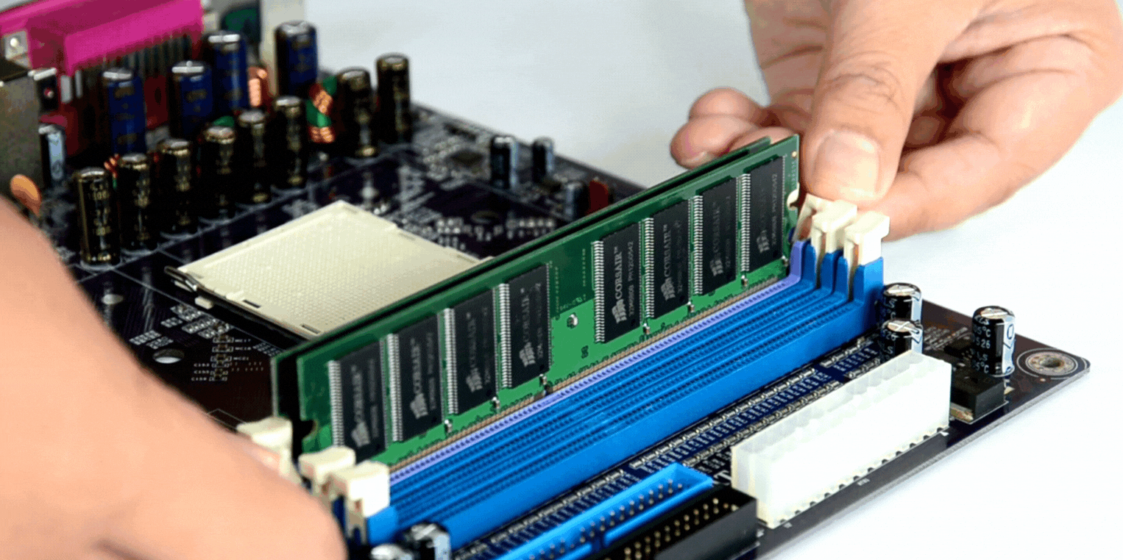
Let’s talk!
1. How has increased computer memory changed business?
2. When do people need to add more computer memory?

Slide 24


Watch the video about computer memory and find an answer to the question on how computer memory works

Slide 25

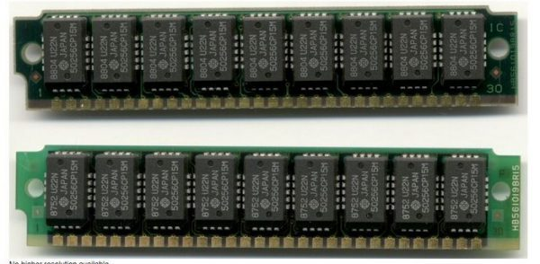
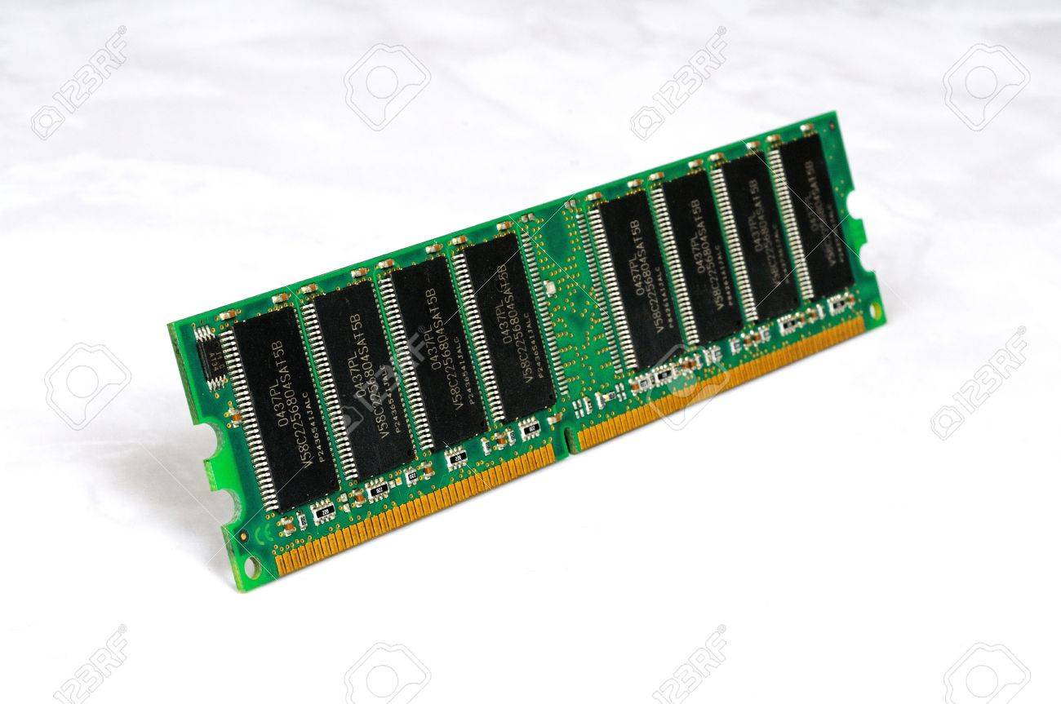
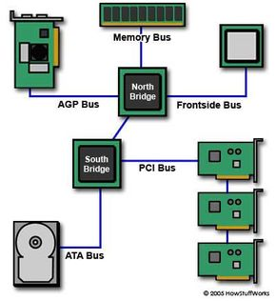
Let’s boost your vocabulary!
SIMMs – Single Inline Memory Module is an older type of memory module. It sends up to 32 bits of data to CPU.
DIMMs – Dual Inline Memory Module is a newer type of memory module. It sends 64 bits of data to the CPU.
Bus speed – a computer’s bus speed measures how many times the CPU can access a group of bits per second. This is measured in MHz.

Slide 26

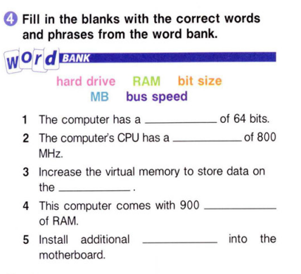

Computer Memory
Despite being red, Mars is a cold place
bit size
bus speed
Venus has a beautiful name, but it’s terribly hot
hard drive
Mercury is the closest planet to the Sun
MB
RAM

Slide 27
MHz | DIMM | bit | SIMM | motherboard | virtual memory | paging file
A. where data that doesn’t fit in the RAM is stored ___________
B. the main circuit board in a computer ____________
C. a unit of measurement that measures the speed of a CPU _______
D. a data storage method that stores data on the hard drive ________
E. the smallest unit of computer data _____________
F. a memory module that sends up to 32 bits of data to a CPU ______
G. a memory module that sends up to 64 bits of data to a CPU ______
Answers: 1. paging file; 2. motherboard; 3. MHz; 4. virtual memory; 5. bit; 6. SIMM; 7. DIMM

Slide 28
Grammar Focus: Imperative Sentences
An imperative sentence gives a direct command to an implied second person and it addresses an implied second person with a request, command, instruction, or invitation.
Example: "Open Task Manager by pressing Ctrl + Shift + Esc."
Explanation: This command directs the user to open Task Manager, a built-in tool for checking memory usage.
Example: "Navigate to the 'Performance' tab."
Explanation: This instructs the user to go to a specific tab within Task Manager to view memory statistics.
erative sentences do not have a subject.

Slide 29

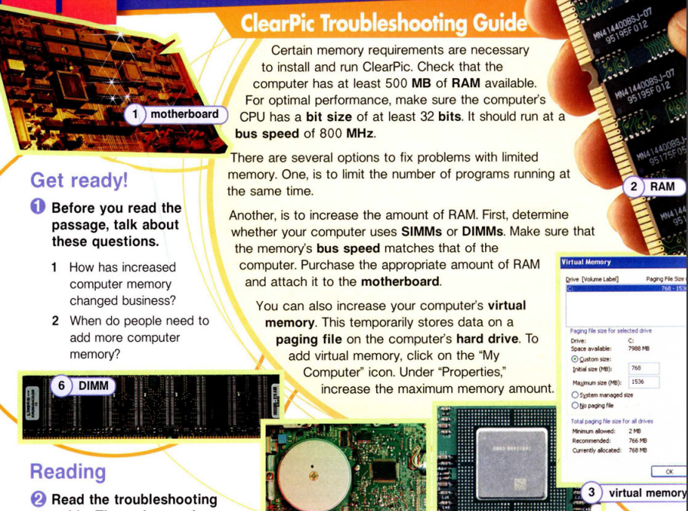
THEM
US
Mercury is the closest planet to the Sun and the smallest one in the
Solar System
Venus is the second planet from the Sun. Its atmosphere is extremely poisonous

Slide 30

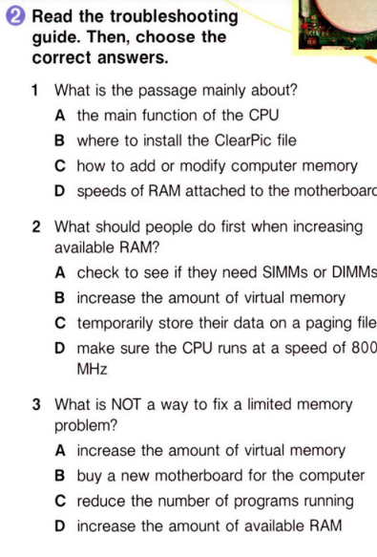

02

Slide 31
Find a peer
Students will be divided into two groups and a teacher will distribute cards with written terms related to the topic to the first group and definitions of the terms to the other group. Students need to find the definition or the term of the definition by mingling in the class. Ultimately, reviewing vocabulary in this way students will be peered for future activity.

Slide 32

Read the text about types of computer memory and write imperative sentences based on it.

Slide 33
Work in pairs and create troubleshooting guides with imperative sentences.
Example: Ensure RAM modules are properly seated in their slots. Look for any dust or debris inside the computer; clean it gently.

Slide 34
Listen to a conversation and mark the statements as True or False.
1. The customer's CPU is too slow to run the program.
True
False
2. The employee advises the customer to buy more RAM.
True
False
3. Increasing the virtual memory will increase the paging file size.
True
False

Slide 35
Listen again and complete the conversation
Employee: Good morning. How can I help you?
Customer: Hi. I installed ClearPic and I'm trying to run it. But the program keeps freezing.
Employee: How much memory is available on your computer?
Customer: It has 256 MB of RAM.
Employee: Well, 1) _____. To run ClearPic you really want to have at least 500 MB of memory.
Customer: So how can I fix that?
Employee: One easy way is to increase your computer's 2) _______________.
Customer: What will that do?
Employee: It increases the paging file size. That way, your computer's 3) _______ can store more data.
Customer: I see. So 4) _______ do I increase the memory?
Employee: 5) ____ on the ‘My Computer’ icon. Under ‘Properties,’ increase the maximum memory amount _____6) half.
Customer: Okay. Thanks for your help!

Slide 36
Answers: 1. there’s your problem; 2. virtual memory; 3. hard drive; 4. how exactly; 5. Just click; 6. by at least

Slide 37

Use the words below to complete the text

Slide 38
cores | technology | read | optical | purchase | faster
Special Agent Nickolaos Contaxakis gives his advice on what 1) ________ terms one should be aware of, prior to buying a new computer. A buyer can 2) _______ a dual core or quad core for their computer. Mr. Contaxakis explains that the more 3) ________ the computer has, the more brain power it has. Regarding the speed of the processor, the more gigahertz that are available the 4)__________ it will work. Also, the larger the hard drive the more information can be stored on it. Lastly, the 5) _________ drive, otherwise known as a CD or DVD drive, is the section of the computer that allows it to 6) movies or regular music.
Answers: 1. technology; 2. purchase; 3. cores; 4. faster; 5. optical; 6. read

Slide 39



Home Assignment
Learn the terms/specific words which you studied during the lessons.
Get ready to make the presentation.

Slide 40
Analyze the memory usage of your own computer or another device you use regularly.
Instructions:
- Use built-in tools or third-party software to check the current RAM and virtual memory usage.
- Document how much RAM is in use, how much is available, and how virtual memory is being utilized.
- Identify and list the programs that are consuming the most memory.
- Write a 1-page report of your findings, including screenshots or graphs if possible.
Tips:
Using Third-Party Software:
Download and Install: Download from CPU-Z's official website
Task Manager:
Open Task Manager:
Press Ctrl + Shift + Esc or Ctrl + Alt + Del and select "Task Manager."
Check RAM Usage:
Go to the "Performance" tab.
Click on "Memory" to see the current RAM usage, available memory, and other details.
Check Virtual Memory:
Go to the "Performance" tab.
Click on "Memory," then scroll down to see "Virtual Memory" statistics at the bottom of the window.

Slide 41

THANKS!
Do you have any questions?

